Slide 1
Question 2: What factors contribute to the performance of the USD, and how can we achieve a more balanced trade-off between precision and recall from regressors for better prediction of future performance?
Moustapha Cisse

Slide 2
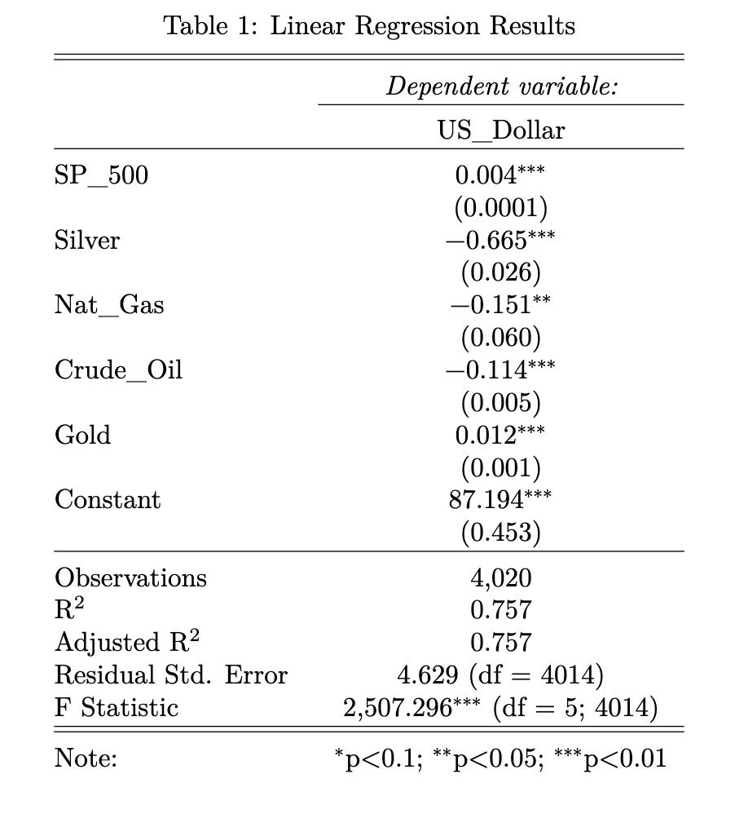
Regressions
Linear:
- All regressors are siginicant.
- Approx 75% of the population
All regressors have an impact on the us dollar.

Slide 3
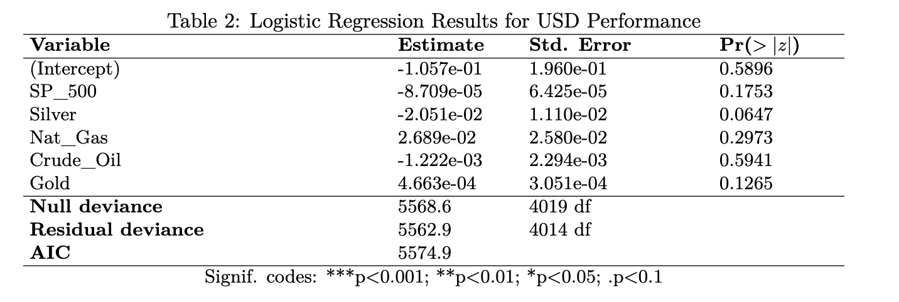
Logit
- non significance of regressors

Slide 4
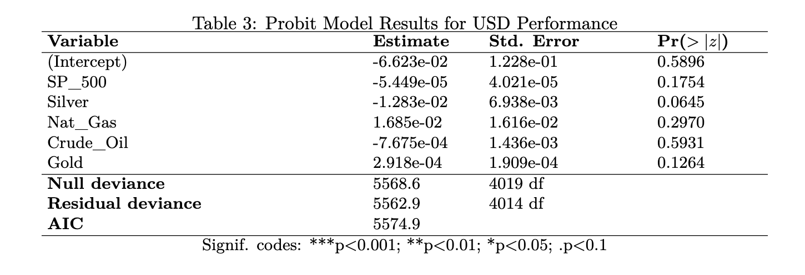
* Probit
- Non significance of regressors
-

Slide 5
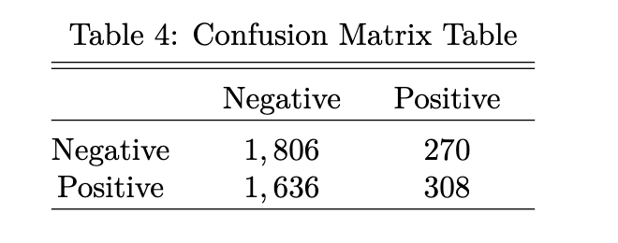
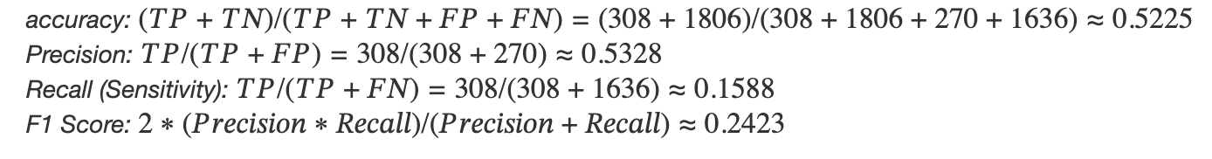
The number of instances where the model correctly predicted USD_perform as a good performance is 308.
The proportion of correctly predicted instances based on the model is approx. 52%.

Slide 6
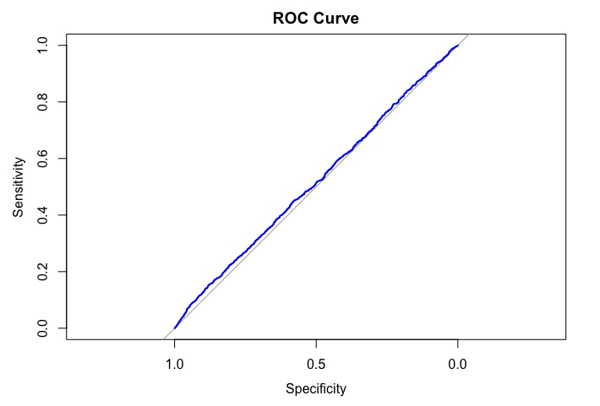
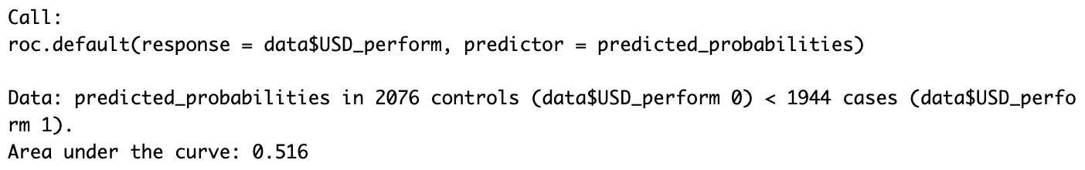
ROC Curve
AUC < 0.8
Not a very good model

Slide 7
Based on the non significance of our regressors, and the low AUC, we cannot conclude that these variables can impact future performance of the USD. More data needed

